Slide 1
Introduction to VisionPLUS

Slide 2
What is VisionPLUS?
VisionPLUS is a financial software application from First Data Corporation. Originally developed by the Paysys Research and Development Group.
VisionPLUS is a family of totally integrated software products.
VisionPlus is mainly used for credit card transaction processing.
VisionPLUS consists of modules that work together to fully manage your company’s credit environment.

Slide 3
Features and benefits of the VisionPLUS
VisionPLUS offers financial institutions the flexibility to configure their own product features and functionality.
VisionPlus offers Multi-currency and multi-language facilities, in addition to complete bankcard compliance, enable full support for operations anywhere in the world.
VisionPLUS offers outstanding batch processing capability that increases speed and efficiency.
VisionPlus offers transaction processing facilities for credit card, debit card, prepaid cards and closed end loan.

Slide 4
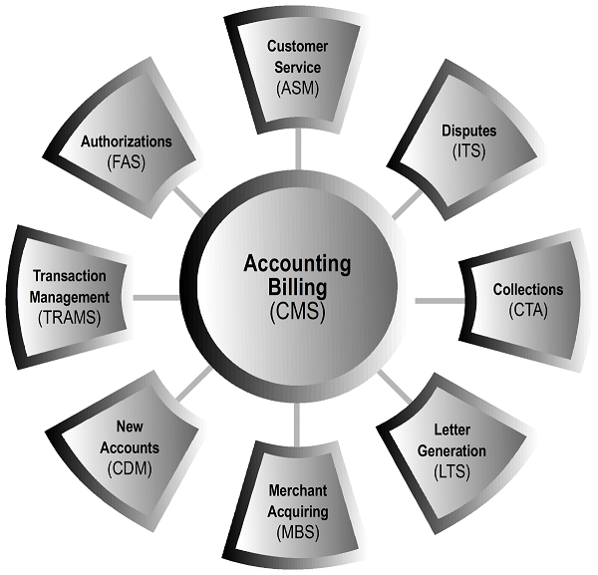
VisionPlus Modules

Slide 5
CDM - Credit Decision Management
The Credit Decision Management system (CDM) is the new accounts module. This online system is designed to handle the credit approval process from the point of application to the point of approval or decline. Applications are taken through processing steps that mirror the underwriting process and can be categorized and treated according to the parameters set by your company. While the entire process can be automated, human intervention can occur at any point within the process, the choice is yours.

Slide 6
CDM Functionalities
Application Input
Edit Process
Pre-validation
Cross-check
Application Scoring
Credit Bureau Scoring
Combined Scoring
Final Judgement
Setup Process

Slide 7
CMS - Credit Management System
The Credit Management System (CMS) is the accounts receivable system that functions as the heart of VisionPLUS. CMS holds the demographic, financial, and historical information for each account. Other VisionPLUS modules needing that information obtain it from CMS, eliminating record duplication. CMS also contains user-defined parameters for interest, billing, insurance, payment, and account processing.

Slide 8
CMS Functionalities
Account Boarding
Account Walkthrough
Monetary Transaction processing
Non-Monetary Transaction processing
Account Control Table
Processing Control table
Service Charge Fee table
Interest Processing
Payment Processing
Plan Master
Plan Segment

Slide 9
ASM - Account Services Management
The Account Services Management system (ASM) is the online, real-time customer service module. ASM enhances your ability to provide superior customer service by utilizing user-defined action codes to perform customer-generated requests such as interest adjustments, address changes, and disputes.

Slide 10
ASM Functionalities
Inquiry Action code processing
Monetary Action code processing
Non-Monetary Action code processing
Transcript Action code processing
Point Action code processing
System generated Action code processing

Slide 11
FAS - Financial Authorization System
The Financial Authorization System (FAS) is the 24-hour-a-day, 7-day-a-week authorization module. FAS processes retail, Visa, MasterCard, and Europay authorizations based upon user defined processing parameters. Authorizations can be approved, declined, or referred. FAS also provides authorization reversals, card recovery listing and updates, and event/delayed advice retrievals.

Slide 12
FAS Functionalities
Real time Update of Open-To-buy
velocity Checks
Online Display of Account/Store authorization activity
Authorizations requests

Slide 13
FAS Functionalities for VISA & MasterCard
Address Verification Service
Alternative Acquirer Routing Capability
Verification of PIN and ATM balance Inquiries
Automatic Cardholder Database Update
Verification of CVC (MasterCard)
Automatic Repeat Authorizations (VISA)
Verification of CVV (VISA)

Slide 14
TRAMS - Transaction Management System
The Transaction Management System (TRAMS) is the VisionPLUS front-end processor. TRAMS accepts multiple transaction types and prepares them for any destination, consolidating numerous application front-ends into a single input system. TRAMS also provides extensive job tracking, settlement, warehousing, reporting, reject, and online reject and suspense handling capabilities.

Slide 15
TRAMS Functionalities
TRAMS Base
TRAMS BC (Bankcard Compliance)
TRAMS AG/NG
TRAMS DE
Reject Reentry
Mirror File Recovery
Clearing and Settlement
Auto Chargeback
TRAMS Online

Slide 16
MBS - Merchant Bankcard System
The Merchant Bankcard System (MBS) is the merchant acquiring system. MBS supports both bankcard and retail merchant processing providing an efficient way to settle funds and charge the merchant fees for services rendered. MBS offers discount, participation, reserve funding, and volume bonus processing along with comprehensive activity reporting.

Slide 17
MBS Functionalities
Merchant Deposits
Merchant Statement
Merchant Settlement
Merchant Invoicing
Merchant Participation
Merchant Adjustment
Discount and Fee Calculations
Interface with TRAMS and CMS

Slide 18
LTS - Letter System
The Letter System (LTS) is the module that can be used to create and issue letters for up to five different PaySys products. Letter variables from these different modules can be embedded within generic letters to produce letters tailored to individual customers. Letters can be printed real-time or in batch processing.

Slide 19
LTS Functionalities
LTDT Creation
Letter Definition
Letter Generation
Letter Master
Letter Variables

Slide 20
ITS - Interchange Tracking System
The Interchange Tracking System (ITS) is the dispute tracking and processing module. ITS is designed to process incoming and outgoing chargeback transactions for both Visa, MasterCard, as well as some regional associations such as Europay (for Eurocard-MasterCard only) and Australian Bankcard. ITS keeps track of many user-defined parameters, such as time limits to keep your business compliant with the different associations. Chargebacks are “worked” through queues based on criteria that you define creating a customized, organized workflow.

Slide 21
ITS Functionalities
Retrieval Request (Copy Request)
Chargeback
Cardholder Adjustment
Reverse Transaction
Misapplied Transaction
Fraud Transaction

Slide 22
CTA - Collections, Tracking, and Analysis
The Collections, Tracking, and Analysis module (CTA) is designed to categorize and treat accounts that need special handling. While the system was designed primarily to handle past-due accounts, it can be used to track and analyze other groups of accounts that may or may not need actual treatment. These groups may include VIPs, lost or stolen cards, overlimit accounts, and bankruptcy cases. CTA offers flexible collection strategies based on how your company sets the control record parameters.

Slide 23
CTA Functionalities
Account newly tagged in collection
Restructure account
Monetary update
Non-monetary update
Account transfer
Letter update
Agency file upload
Agency file download
Account recovered from collections and moving back to CMS

Slide 24
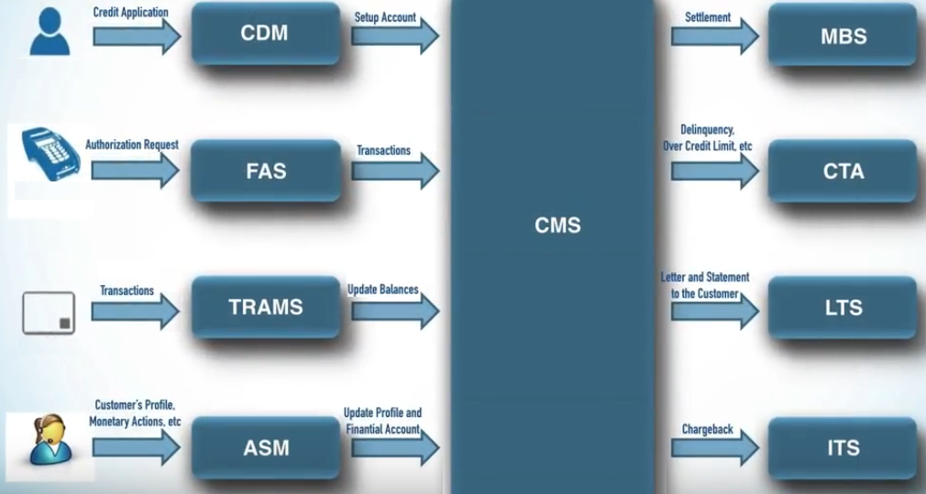
Transaction flow within VisionPlus Modules

Slide 25
Thank You

